Slide 1
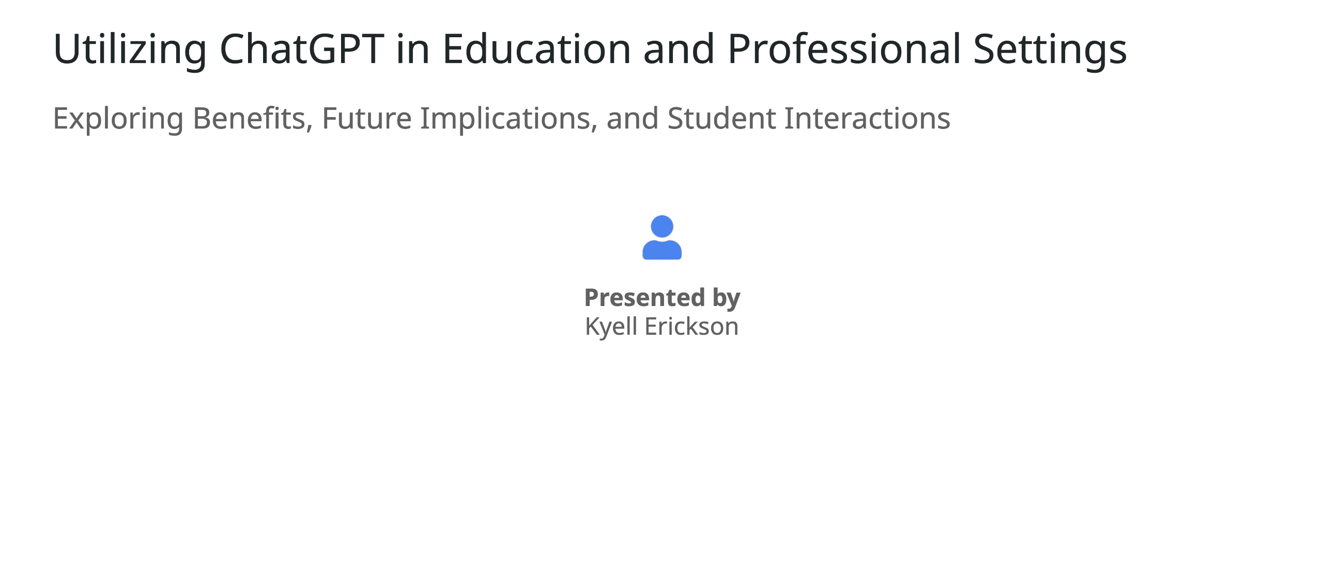
Notes:
Welcome to this presentation on utilizing ChatGPT in education and professional environments. My name is Kyell Erickson, and today, we'll be diving into how this powerful AI tool can be leveraged to enhance learning experiences, improve efficiency in educational settings, and support educators in their day-to-day tasks. We'll also touch on future implications and explore how students can interact with ChatGPT in a responsible and innovative way. By the end of this session, I hope to show you how AI can seamlessly integrate into both classrooms and professional environments, providing significant benefits for all involved.

Slide 2
Notes:
ChatGPT, developed by OpenAI, is a remarkable innovation in the field of AI. It's designed as a conversational language model that can generate text responses based on inputs it receives. This means it can help answer questions, provide explanations, and even engage in creative writing. With its capabilities, professionals in many industries—from content creation to data analysis—are finding ways to streamline their tasks using ChatGPT. It acts as both an assistant and a tool for improving efficiency, making it an asset in a variety of settings, including education, which we'll explore next.

Slide 3
Notes:
In educational environments, ChatGPT has the potential to revolutionize how tasks are handled. One of the key advantages is the efficiency it brings to everyday tasks. Educators can now automate repetitive duties like writing emails or creating reports, freeing up more time to focus on students. It also assists with research by providing concise summaries of academic texts. ChatGPT further enables customization in learning, allowing teachers to tailor lessons to individual student needs. Finally, ChatGPT supports curriculum creation by generating quizzes, feedback templates, and even offering tutoring assistance for complex topics.

Slide 4
Notes:
This section is dedicated to showcasing how ChatGPT operates in real-time. The way it processes inputs is truly impressive—it analyzes what is fed into it and predicts the most appropriate responses. It can provide context-aware answers, making it a versatile tool across different fields. We'll run a few live demonstrations to see how ChatGPT can assist with common tasks, including creating lesson plans, providing feedback on essays, and summarizing complex academic material for younger students. This live interaction will illustrate the breadth of its capabilities and usefulness in educational contexts.

Slide 5
Notes:
Introducing any new technology can create barriers to understanding—whether it's because of unfamiliarity, fear of making mistakes, or reluctance to adopt new tools. ChatGPT is no different. However, these barriers can be overcome through practical demonstrations of its real-world applications. By providing hands-on examples tailored to specific fields, such as administrative tasks for school staff or lesson preparation for teachers, we can bridge this gap. Encouraging questions from the start is another critical approach, as it breaks down misconceptions and builds comfort with using the tool.

Slide 6
Notes:
One of the best features of ChatGPT is its versatility across various fields of study. For math, ChatGPT can generate practice problems or explain the steps in complex calculations. For English, it offers valuable feedback on grammar, style, and structure, and even suggests creative writing prompts. In science, it helps break down complicated concepts like quantum physics into understandable terms, or even create case studies for discussion. It also customizes the difficulty level based on the students' age or expertise, making it a powerful tool across subjects.

Slide 7
Notes:
In professional settings, ChatGPT can help streamline tasks that usually take up a significant amount of time. Tasks like writing emails, drafting reports, and summarizing large documents can be easily automated. This allows professionals, such as teachers, to focus on more critical aspects of their roles. For instance, a teacher can use ChatGPT to turn long reports or texts into quick, digestible bullet points, freeing up time to concentrate on student engagement. This provides an invaluable balance between productivity and maintaining work-life harmony.

Slide 8
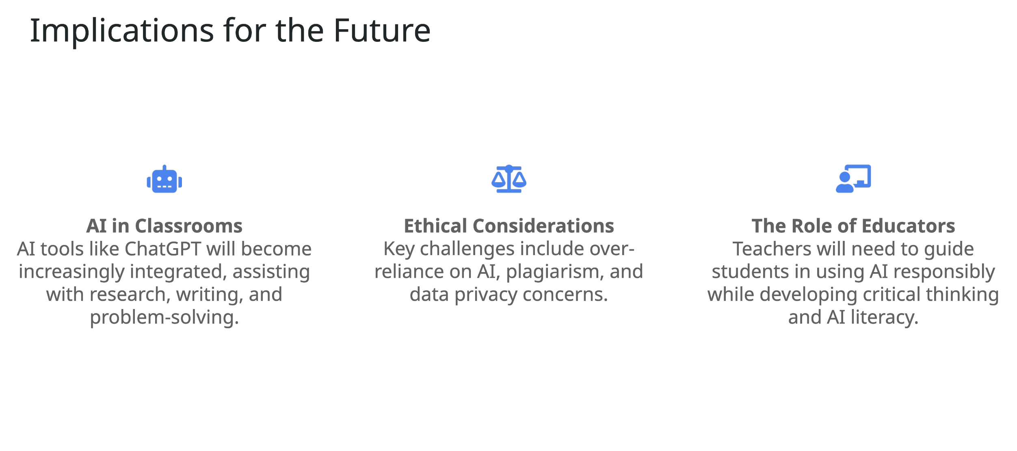
Notes:
Looking into the future, AI will become an essential tool in classrooms, enhancing how students engage with research, writing, and complex problem-solving. However, this also raises important ethical considerations. Teachers must guide students in responsible AI usage, ensuring that they understand how to use these tools without becoming over-reliant or engaging in plagiarism. Moreover, protecting student data and fostering a balance between AI-driven insights and human creativity will be crucial. Educators will play a vital role in shaping how students use AI, blending technological literacy with critical thinking skills.

Slide 9
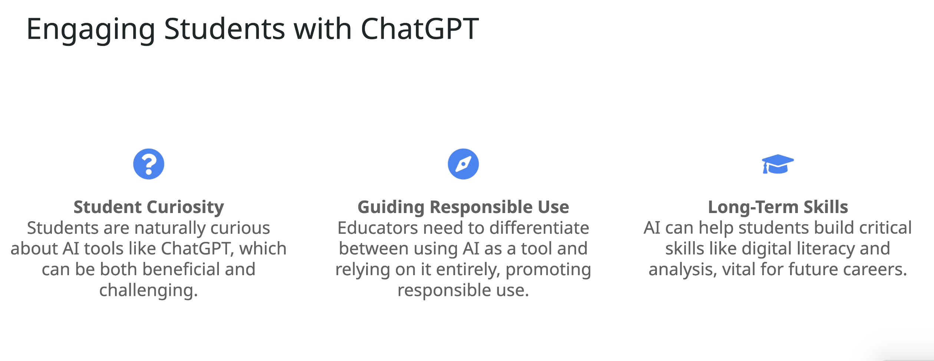
Notes:
Engaging students with AI tools like ChatGPT is an exciting prospect, as students are naturally inclined to explore new technologies. However, while curiosity is beneficial, it's crucial to guide them in using these tools responsibly. Educators must emphasize the importance of using AI as a supportive tool, not as a shortcut for critical thinking or original work. By introducing ChatGPT in the right way, teachers can help students develop key long-term skills, such as digital literacy and analytical thinking, which will be critical in their future academic and professional endeavors.

Slide 10
Notes:
As we conclude, it's clear that ChatGPT offers a wide array of benefits for both educators and students. From streamlining administrative tasks to enhancing lesson plans, this tool can significantly improve productivity and enrich the educational experience. However, its responsible use and thoughtful integration into classrooms are key to maximizing its potential. I invite any questions or thoughts on how you envision using ChatGPT in your own work.

